Slide 1
Inter-process communication

Slide 2
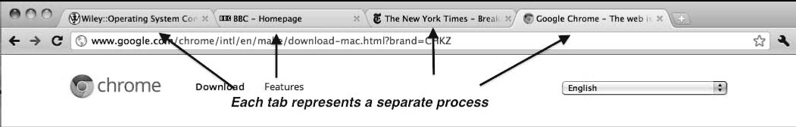
Multiprocess Architecture – Chrome Browser
Many web browsers ran as single process (some still do)
If one web site causes trouble, entire browser can hang or crash
Google Chrome Browser is multiprocess with 3 categories
Browser process manages user interface, disk and network I/O
Renderer process renders web pages, deals with HTML, Javascript, new one for each website opened
Runs in sandbox restricting disk and network I/O, minimizing effect of security exploits
Plug-in process for each type of plug-in

Slide 3
Interprocess Communication
Processes within a system may be independent or cooperating
Cooperating process can affect or be affected by other processes, including sharing data
Reasons for cooperating processes:
Information sharing
Computation speedup
Modularity
Convenience
Cooperating processes need inter-process communication (IPC)
Two models of IPC
Shared memory Message passing

Slide 4
Communications Models

Slide 5
Cooperating Processes
Independent process cannot affect or be affected by the execution of another process
Cooperating process can affect or be affected by the execution of another process
Advantages of process cooperation
Information sharing
Computation speed-up
Modularity
Convenience

Slide 6
Producer-Consumer Problem
Paradigm for cooperating processes, producer process produces information that is consumed by a consumer process
unbounded-buffer places no practical limit on the size of the buffer
bounded-buffer assumes that there is a fixed buffer size

Slide 7
Bounded-Buffer – Shared-Memory Solution
Shared data
#define BUFFER_SIZE 10
typedef struct {
. . .
} item;
item buffer[BUFFER_SIZE];
int in = 0;
int out = 0;
Solution is correct, but can only use BUFFER_SIZE-1 elements

Slide 8
Bounded-Buffer – Producer
item next_produced;
while (true) {
/* produce an item in next produced */
while (((in + 1) % BUFFER_SIZE) == out)
; /* do nothing */
buffer[in] = next_produced;
in = (in + 1) % BUFFER_SIZE;
}

Slide 9
Bounded Buffer – Consumer
item next_consumed;
while (true) { while (in == out)
; /* do nothing */ next_consumed = buffer[out];
out = (out + 1) % BUFFER_SIZE;
/* consume the item in next consumed */
}

Slide 10
Interprocess Communication – Message Passing
Mechanism for processes to communicate and to synchronize their actions
Message system – processes communicate with each other without resorting to shared variables
IPC facility provides two operations:
send(message) – message size fixed or variable
receive(message)

Slide 11
Interprocess Communication – Message Passing
If P and Q wish to communicate, they need to:
establish a communication link between them
exchange messages via send/receive
Implementation of communication link
physical (e.g., shared memory, hardware bus)
logical (e.g., direct or indirect, synchronous or asynchronous, automatic or explicit buffering)

Slide 12
Implementation Questions
How are links established?
Can a link be associated with more than two processes?
How many links can there be between every pair of communicating processes?
What is the capacity of a link?
Is the size of a message that the link can accommodate fixed or variable?
Is a link unidirectional or bi-directional?

Slide 13
Direct Communication
Processes must name each other explicitly:
send (P, message) – send a message to process P
receive(Q, message) – receive a message from process Q
Properties of communication link
Links are established automatically
A link is associated with exactly one pair of communicating processes
Between each pair there exists exactly one link
The link may be unidirectional, but is usually bi-directional

Slide 14
Indirect Communication
Messages are directed and received from mailboxes (also referred to as ports)
Each mailbox has a unique id
Processes can communicate only if they share a mailbox
Properties of communication link
Link established only if processes share a common mailbox
A link may be associated with many processes
Each pair of processes may share several communication links
Link may be unidirectional or bi-directional

Slide 15
Indirect Communication
Operations
create a new mailbox
send and receive messages through mailbox
destroy a mailbox
Primitives are defined as:
send(A, message) – send a message to mailbox A
receive(A, message) – receive a message from mailbox A

Slide 16
Indirect Communication
Mailbox sharing
P₁, P₂, and P₃ share mailbox A
P₁, sends; P₂ and P₃ receive
Who gets the message?
Solutions
Allow a link to be associated with at most two processes
Allow only one process at a time to execute a receive operation
Allow the system to select arbitrarily the receiver. Sender is notified who the receiver was.

Slide 17
Synchronization
Message passing may be either blocking or non-blocking
Blocking is considered synchronous
Blocking send has the sender block until the message is received
Blocking receive has the receiver block until a message is available
Non-blocking is considered asynchronous
Non-blocking send has the sender send the message and continue
Non-blocking receive has the receiver receive a valid message or null

Slide 18
Synchronization (Cont.)
Different combinations possible
If both send and receive are blocking, we have a rendezvous
Producer-consumer becomes trivial
message next_produced;
while (true) { /* produce an item in next produced */
send(next_produced);
}
message next_consumed;
while (true) {
receive(next_consumed);
/* consume the item in next consumed */
}

Slide 19
Buffering
Queue of messages attached to the link; implemented in one of three ways
1. Zero capacity – 0 messages Sender must wait for receiver (rendezvous)
2. Bounded capacity – finite length of n messages Sender must wait if link full
3. Unbounded capacity – infinite length Sender never waits

Slide 20
Example of ipc systems

Slide 21
Examples of IPC Systems - POSIX
POSIX Shared Memory
Process first creates shared memory segment shm_fd = shm_open(name, O CREAT | O RDWR, 0666);
Also used to open an existing segment to share it
Set the size of the object
ftruncate(shm fd, 4096);
Now the process could write to the shared memory
sprintf(shared memory, "Writing to shared memory");

Slide 22
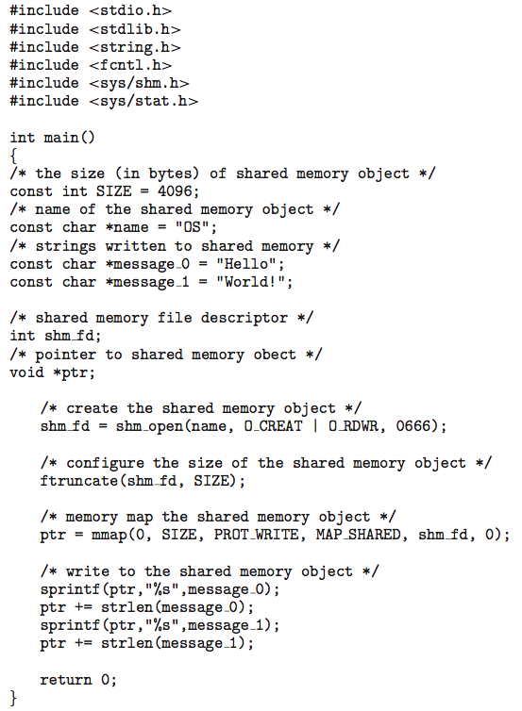
IPC POSIX Producer

Slide 23
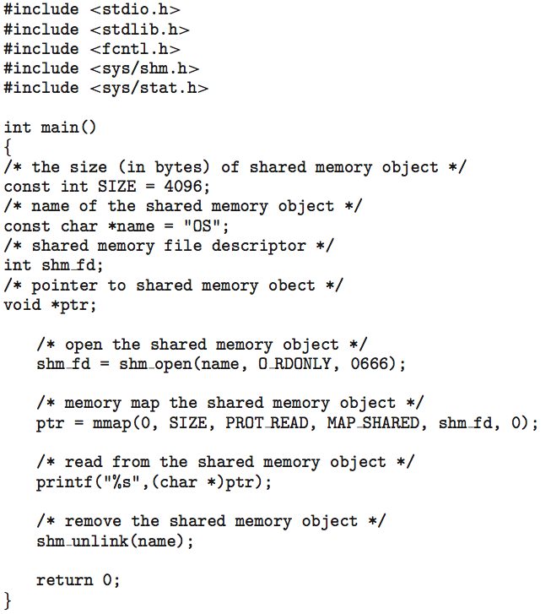
IPC POSIX Consumer

Slide 24
Examples of IPC Systems - Mach
Mach communication is message based
Even system calls are messages
Each task gets two mailboxes at creation- Kernel and Notify
Only three system calls needed for message transfer
msg_send(), msg_receive(), msg_rpc()
Mailboxes needed for commuication, created via
port_allocate()
Send and receive are flexible, for example four options if mailbox full:
Wait indefinitely
Wait at most n milliseconds
Return immediately
Temporarily cache a message

Slide 25
Examples of IPC Systems – Windows
Message-passing centric via advanced local procedure call (LPC) facility
Only works between processes on the same system
Uses ports (like mailboxes) to establish and maintain communication channels
Communication works as follows:
The client opens a handle to the subsystem’s connection port object.
The client sends a connection request.
The server creates two private communication ports and returns the handle to one of them to the client.
The client and server use the corresponding port handle to send messages or callbacks and to listen for replies.

Slide 26
Communication in client-server systems

Slide 27
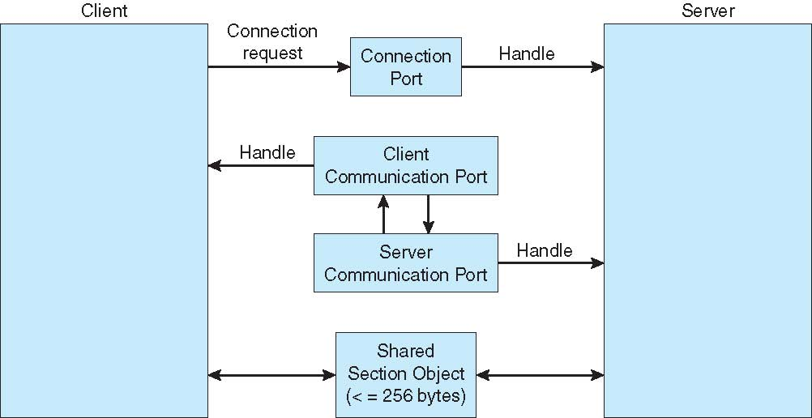
Local Procedure Calls in Windows XP

Slide 28
Communications in Client-Server Systems
Sockets
Remote Procedure Calls
Pipes
Remote Method Invocation (Java)

Slide 29
Sockets
A socket is defined as an endpoint for communication
Concatenation of IP address and port – a number included at start of message packet to differentiate network services on a host
The socket 161.25.19.8:1625 refers to port 1625 on host 161.25.19.8
Communication consists between a pair of sockets
All ports below 1024 are well known, used for standard services
Special IP address 127.0.0.1 (loopback) to refer to system on which process is running

Slide 30
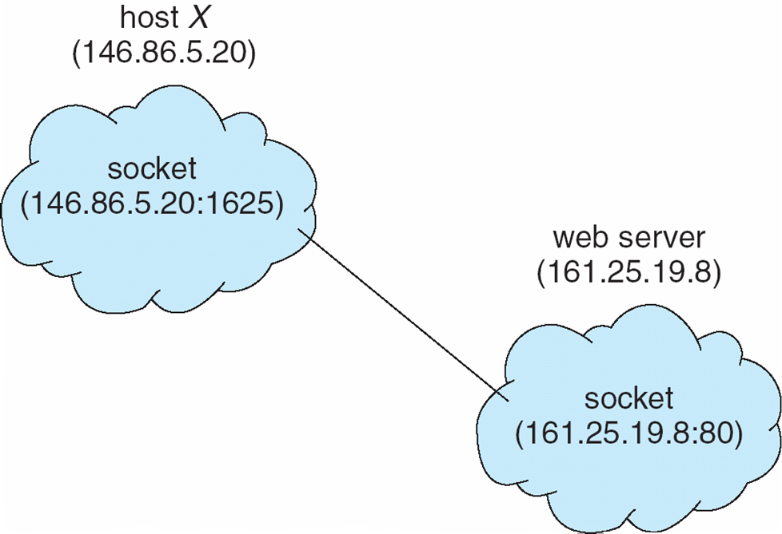
Socket Communication

Slide 31
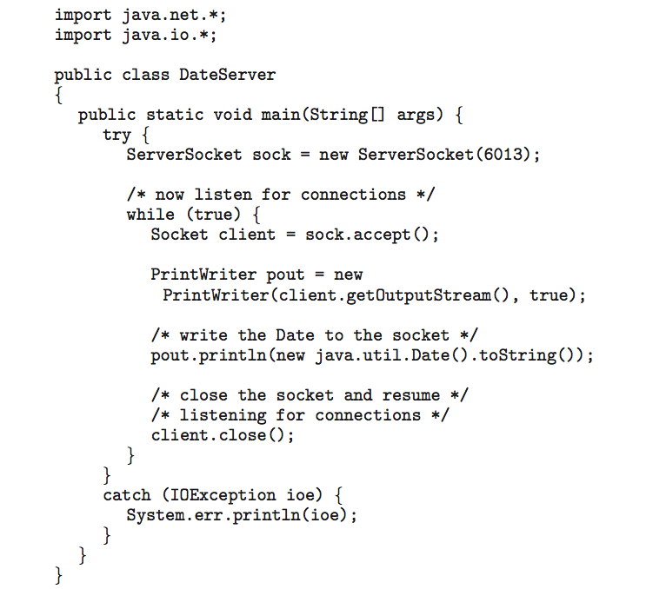
Sockets in Java
Three types of sockets
Connection-oriented (TCP)
Connectionless (UDP)
MulticastSocket class– data can be sent to multiple recipients
Consider this “Date” server:

Slide 32
Remote Procedure Calls
Remote procedure call (RPC) abstracts procedure calls between processes on networked systems
Again uses ports for service differentiation
Stubs – client-side proxy for the actual procedure on the server
The client-side stub locates the server and marshalls the parameters
The server-side stub receives this message, unpacks the marshalled parameters, and performs the procedure on the server

Slide 33
Remote Procedure Calls
On Windows, stub code compile from specification written in Microsoft Interface Definition Language (MIDL)
Data representation handled via External Data Representation (XDL) format to account for different architectures
Big-endian and little-endian
Remote communication has more failure scenarios than local
Messages can be delivered exactly once rather than at most once
OS typically provides a rendezvous (or matchmaker) service to connect client and server

Slide 34
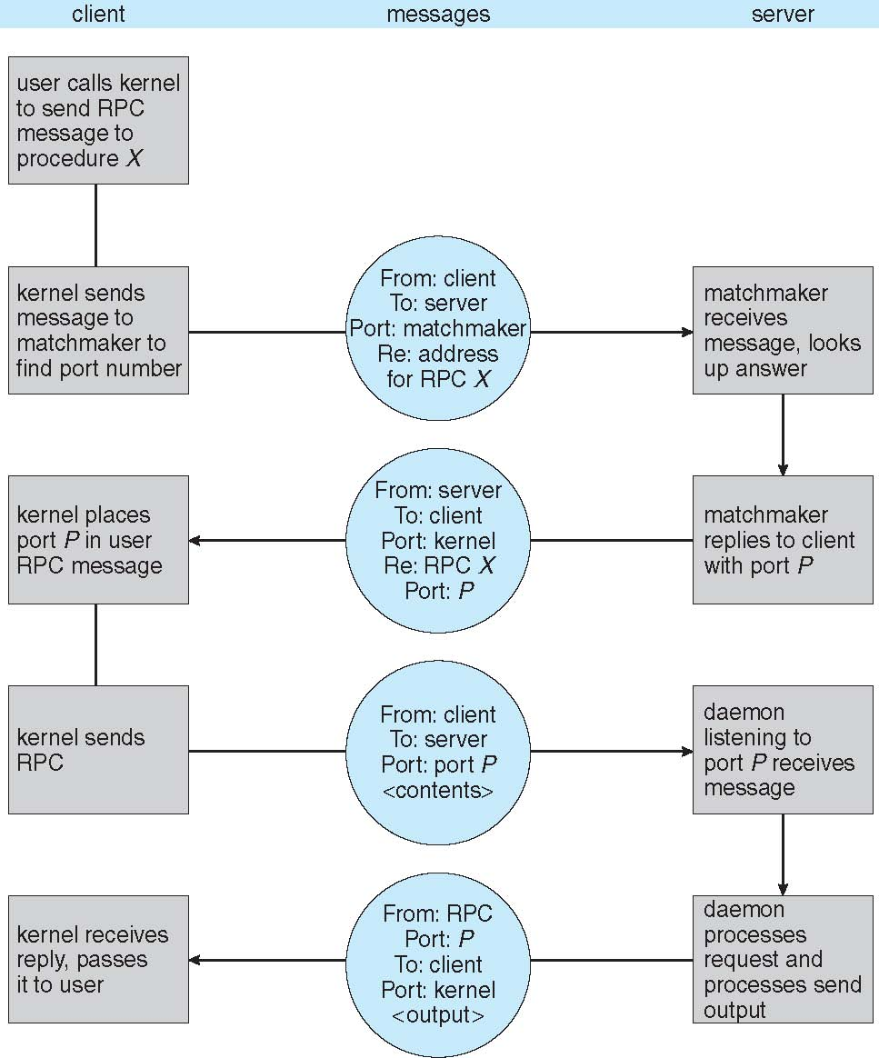
Execution of RPC

Slide 35
Pipes
Acts as a conduit allowing two processes to communicate
Issues
Is communication unidirectional or bidirectional?
In the case of two-way communication, is it half or full-duplex?
Must there exist a relationship (i.e. parent-child) between the communicating processes?
Can the pipes be used over a network?

Slide 36
Ordinary Pipes
Ordinary Pipes allow communication in standard producer-consumer style
Producer writes to one end (the write-end of the pipe)
Consumer reads from the other end (the read-end of the pipe)
Ordinary pipes are therefore unidirectional
Require parent-child relationship between communicating processes

Slide 37
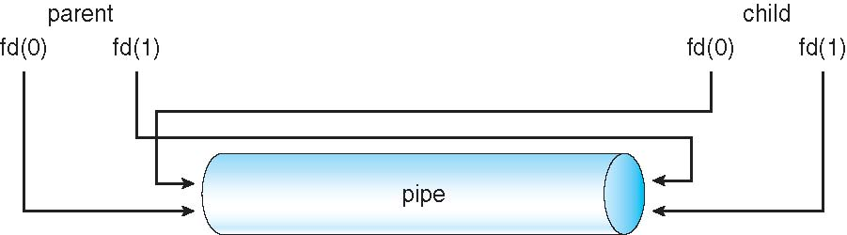
Ordinary Pipes
Windows calls these anonymous pipes
See Unix and Windows code samples in textbook

Slide 38
Named Pipes
Named Pipes are more powerful than ordinary pipes
Communication is bidirectional
No parent-child relationship is necessary between the communicating processes
Several processes can use the named pipe for communication
Provided on both UNIX and Windows systems

Slide 39
End of Chapter 3

